Slide 1

Case Study
      Darcl Logistics

Slide 2







+91-856-00-00-600
www.dialerindia.com
avyuktaindia
CRM Based Dialer - IVR - Cloud Telephony
PRI Card - GSM Gateway - Servers - Headsets
(FXS/FXO/IP Phone// Press 1/ IP PBX)
Auto / Predictive / Hosted – WFH - PC Less – Android - Cloud Dialer
DoT Approved A / A+ Grade VoIP with/out Dialer Combo
Web / Software Development/e-Com / Custom Asterisk Solutions
+1-408-791-3820
+91-856-00-00-600
sales@dialerindia.com

Slide 3

Darcl Case Study
About Darcl
Darcl , Renowned as CJDarcl, is one of 17 Players in India with the license to operate with their Fleet which have Judicious mix of hired and owned container trains, owning sets of Container rakes & containers and Wide range of trailers, trucks, pullers, tippers, tankers, container trucks, platform trucks, tractor, loaders, dumpers and hydraulic axle trailers and many more for bulk goods movement on a pan India basis. Darcl offers end to end transportation enabling last mile connectivity at the journeys origins and destinations with commanding presence in nearly 200 locations across most industrial towns and port cities providing freight to India, and beyond it through extended services to border adjoining areas of neighbouring countries.

Slide 4
Darcl Case Study
Darcl’s Fleet
Vast Fleet Which Delivers Cost Effectiveness, Flexibility and Quality of Service
* Judicious mix of hired and owned fleet, capable of being easily mobilized
* Access to over 1 lac trucks through a network of trusted and reliable vendors
* Over 550 owned vehicles for specialized requirements.
* Owns 3 Container rakes and over 600 containers rake movement.
* Wide range of trailers, trucks, pullers, tippers, tankers, container trucks, platform
trucks, tractor, loaders, dumpers and hydraulic axle trailers, owned container rakes &
containers.
* Capable of moving a large variety of materials such as bulk, break bulk, over
dimensional consignments, liquid bulk, high value and hazardous materials.

Slide 5
Darcl Case Study
Darcl’s Experience
Four Decades of Delivering Value across Verticals, Across Businesses
* Rich experience spanning four decades
* Moved over 11 million tons during last financial year.
* Over 2000 customers including large PSUs, MNCs and Blue Chip companies spanning from biggest businesses to SMEs
Darcl’s Network
Extensive Reach across India, Nepal and Beyond
Darcl’s Technology
Leveraging Technology for Operational Efficiencies
* Fully computerized operations with company-wide ERP-SAP implementation
* Flexible visibility options for en-route consignments with GPS tracking & other
technologies.
* Continued investments towards adoption of advanced and latest technologies

Slide 6
Darcl Case Study
The Real Challenges at Darcl
To maintain lowest possible time and user engagement, Darcl needed a powerful and flexible telecommunication platform. A platform that would maintain user privacy, reduce turnaround time and can be easily integrated with their existing setup. Key area which needs to be taken care are listed as follows:
1. All concerns had to use their own numbers to complete / update assignments over call thereby compromising on their privacy.
2. And no call logs are available on a centralize platform as they are scattered to different team members.
3. All The calls needed to be recorded and must be available to check for quality on just few clicks as the businesses needed real-time tracking of calls.
4. Visibility and Reports for each movement to achieve definite transit schedule towards just in time
5. Calls must be routed to right member only, instead of random user with follow me algorithm.

Slide 7
Darcl Case Study
Solutions we implemented at Darcl
1. Distributed Call Center Solutions
2. Number Masking
3. Follow me call routing.
4. Click to call integration with ERP-SAP.
5. All Recording logs with entire history on just few clicks

Slide 8
Darcl Case Study
Distributed Call Center Solutions
Our Distributed Call Center Solutions implementation helped Darcl to almost eliminated all above challenges
Number Masking
With the help of Number Masking user privacy issue were taken care without any compromises.
Follow me call routing
Follow me routing implementation eliminated the tame taken to manually locate correct concern person to be on call. As such manual process is very much frustrating / confusing and time taking to get the correct person connected. And with follow me routing all calls simply connects to right persons automatically, which improved the performance of team drastically and almost wiped out time taken in manual allocation of right call to the right person.

Slide 9
Darcl Case Study
The Result
1. Our solution helped the client to manage their dealers with auditing and monitoring tools.
2. We helped them with implementation of Automation in process which reduced many manual resources costing with minimal time which improved the overall productivity of work force drastically.
3. Our Specially designed digital system provided them proper reports for all satisfied and unsatisfied customers which helps them to improve the week sections of their services depending upon the reports and feedbacks from customers.
4. With over all implementation of our solution in pan India branches ,Now Customer is satisfied with gradual increase in goal achievements from 60 % to 90 % in just few months.

Slide 10









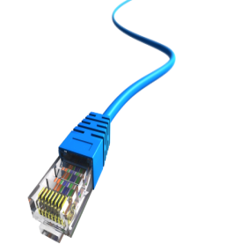
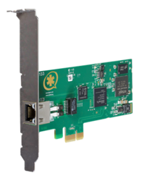
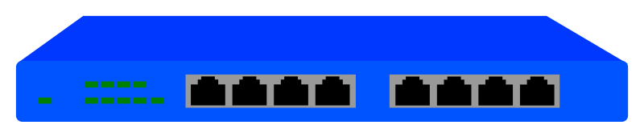
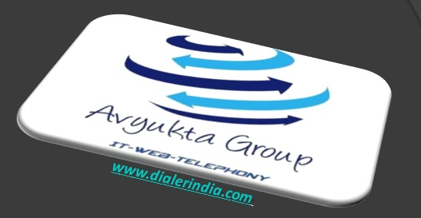

Call Flow And Architecture-Darcl
Inbound Calls from /to India PSTN Network
Call Backs /Outbound from PRI
Agent Floor
Soft Phone
from / to PSTN Incoming Number
Greetings IVR X n Trees
USB Headphones
Admin / Quality / Supervisor / TL PC’s
WAN Modem / Router ( Optional )
Avyukta Dialer Server
Agent PC
Switch
Or Hub
CAT 5/6
PRI Card into PCI Slot
25+ Reports
Voice Logs
Complete Recordings logs
Campaign Manager

Slide 11



Political Elections / Campaigns
Insurance / Shares / Loan / DSA’s
Taxi Services / BPO / Collections
Restaurant / Hotels / Customer Care
E com / Mobile Apps / Website
Survey / Appointment Setting / Lead generation
Astrology / Universities / Colleges
Recruitment / MIS / Placements / Admissions
24 X 7 X 365 “Decade” of 1900+ Satisfied BPO’s
avyuktaindia
Predictive / Auto Dialer: Current Calls/ Output X 400%
Hosted / Premised / BPO / DoT VoIP / PRI / GSM Gateway
Smart IVR / Cloud Telephony / Omni Channel / CRM / API
OBD / Press 1/ Voice SMS / Masking / OTP / 1800
Survey / Appointment Setting / Lead Generation
Domestic International Call Center / BPO Setup
The Competition Assassinators
275+ Live Ref. Centres
11 Yrs. X Asterisks Dev.
9 Countries,91+ Cities
Live Demo / PoC
Lower than the Lowest Professional Bidder
All possible Techno-commercial models
No Blame Game : Your CTI-CRM-VoIP “SPOC”
100% Gov. Compliance
72 HR Refund Policy
10% Ref. discount/s
24X6 Support NoC
“The” single Answer to your
A to Z
Tel- ”e” - calling requirements
+1-408-791-3820
+91-856-00-00-600
sales@dialerindia.com
Avyukta Intellicall www.dialerindia.com

Slide 12





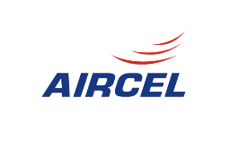

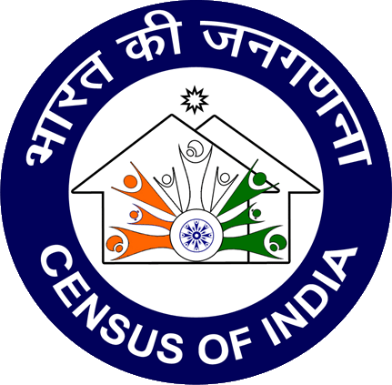


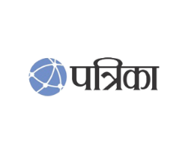





Trust over 11+ years
Some* Major Clients

Slide 13
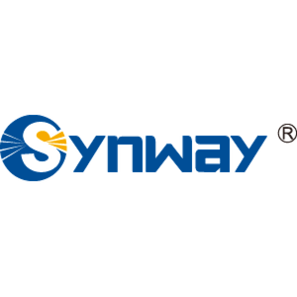

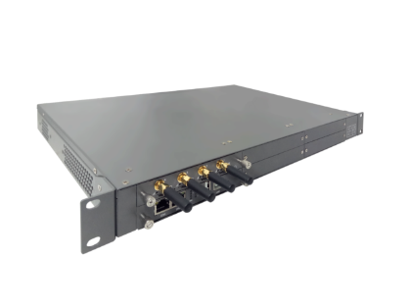



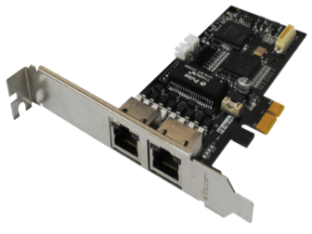



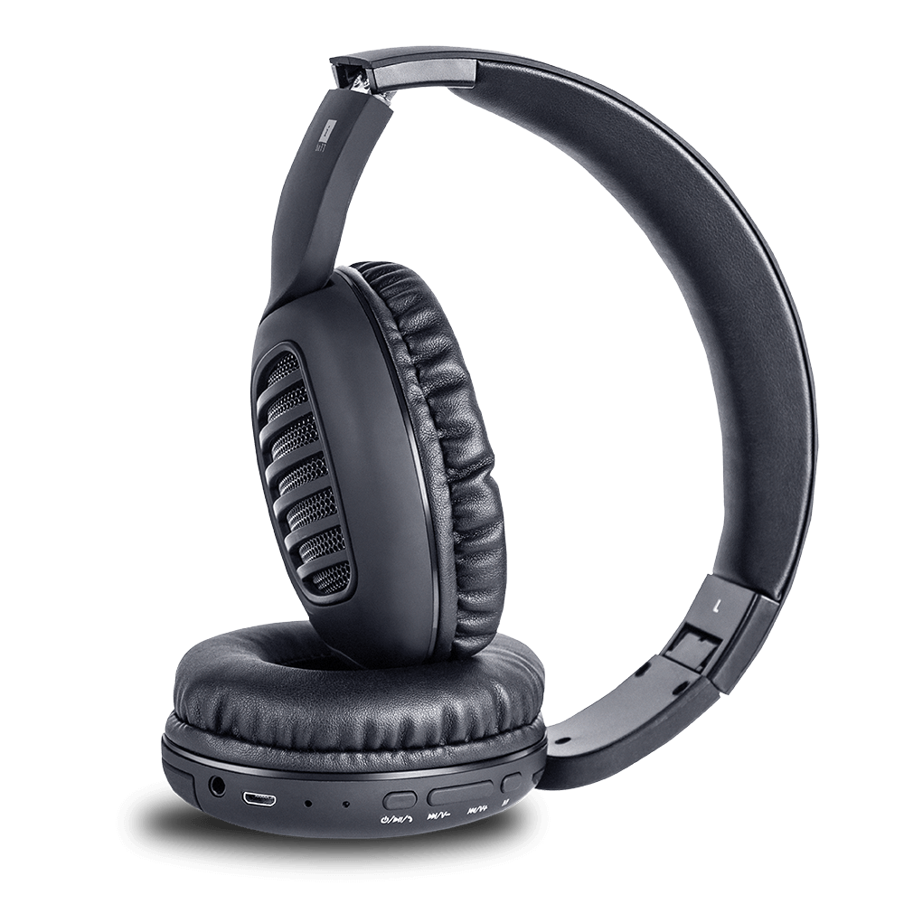



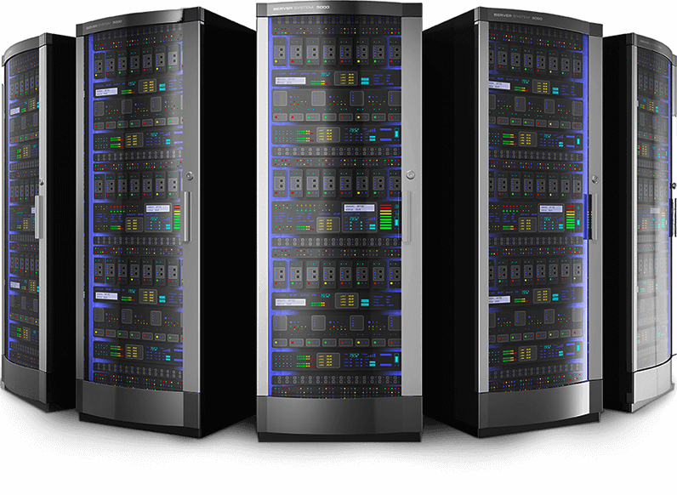
CTI Hardware Partners

Slide 14
Useful links
Domestic Architectures
International Architectures
Demo Video
Video Tutorials
Sample Voice Overs, Jingles and Melodies
DoT License / OSP Registration
PRI card / GSM Gateway / IP Phones / Headphone Buy Online
Vendor Comparison
Avyukta CRM Demo Video
Avyukta Sales CRM Demo Video
Avyukta Task CRM Demo Video
Avyukta Today CRM Demo Video
Request a Demo
Avyukta Client CRM Login
Support SLA
Avyukta on Youtube
Avyukta on Linkedin

Slide 15
Darcl Case Study
Thank You for Your Time

